Slide 1

Let’s Graduate

Slide 2



Learning Assistance Software
Mathematics
History
Hungarian literature
Notes:
It’s a helpful program for students preparing for final exams.
It summerizes revised final exam tasks from previous years in an interactive format, making it easier for seniors to practise tests and recieve immediate feedback.
We cover subjects such as Mathematics, History, and Hungarian language and literature as of now.

Slide 3



Function - Ideas
Main Menu
Progress Reset
User Guide
Adverts
Main Functions
Ideas
Quiz Interface
Newsletter
Review
Spaced Repetition
Task Randomizer
Daily Streak
Dárius Lipták
Zsolt Gáspár
Olivér Bernát

Slide 4
Olivér Bernát
Zsolt Gáspár
Dárius Lipták

Slide 5
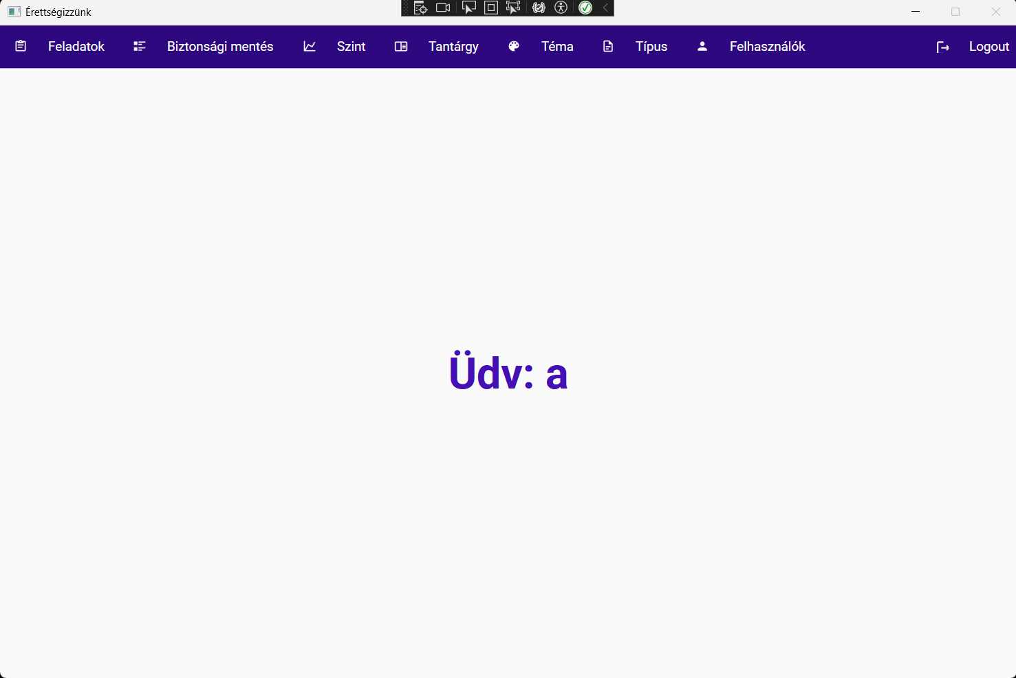
Main tasks:
Backend development
Development of the administrative interface
Olivér Bernát
Admin interface:
Zsolt Gáspár
Dárius Lipták

Slide 6
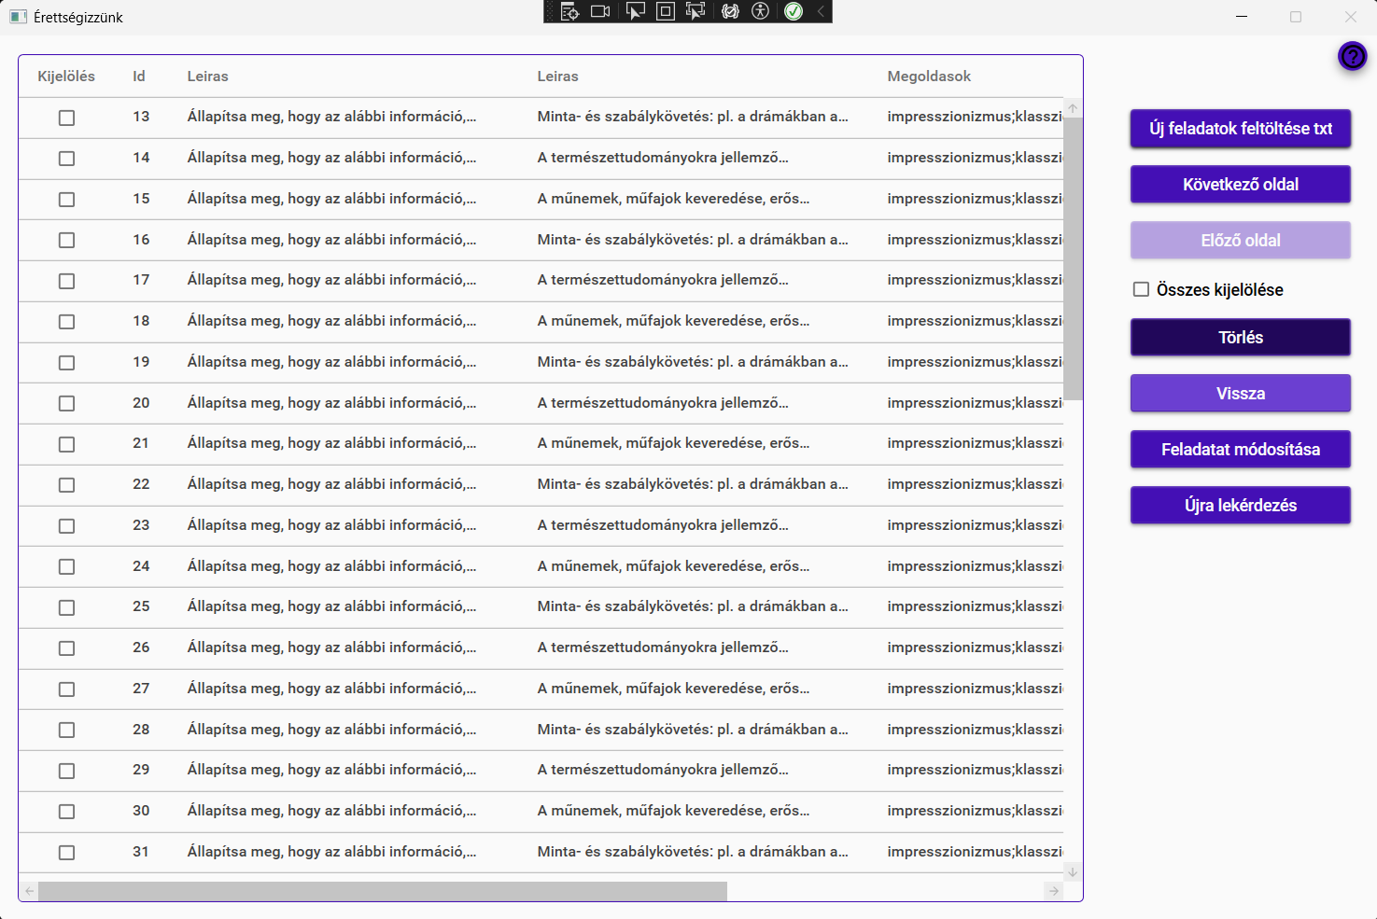
Main tasks:
Backend development
Development of the administrative interface
Olivér Bernát
Admin interface:
Zsolt Gáspár
Dárius Lipták

Slide 7
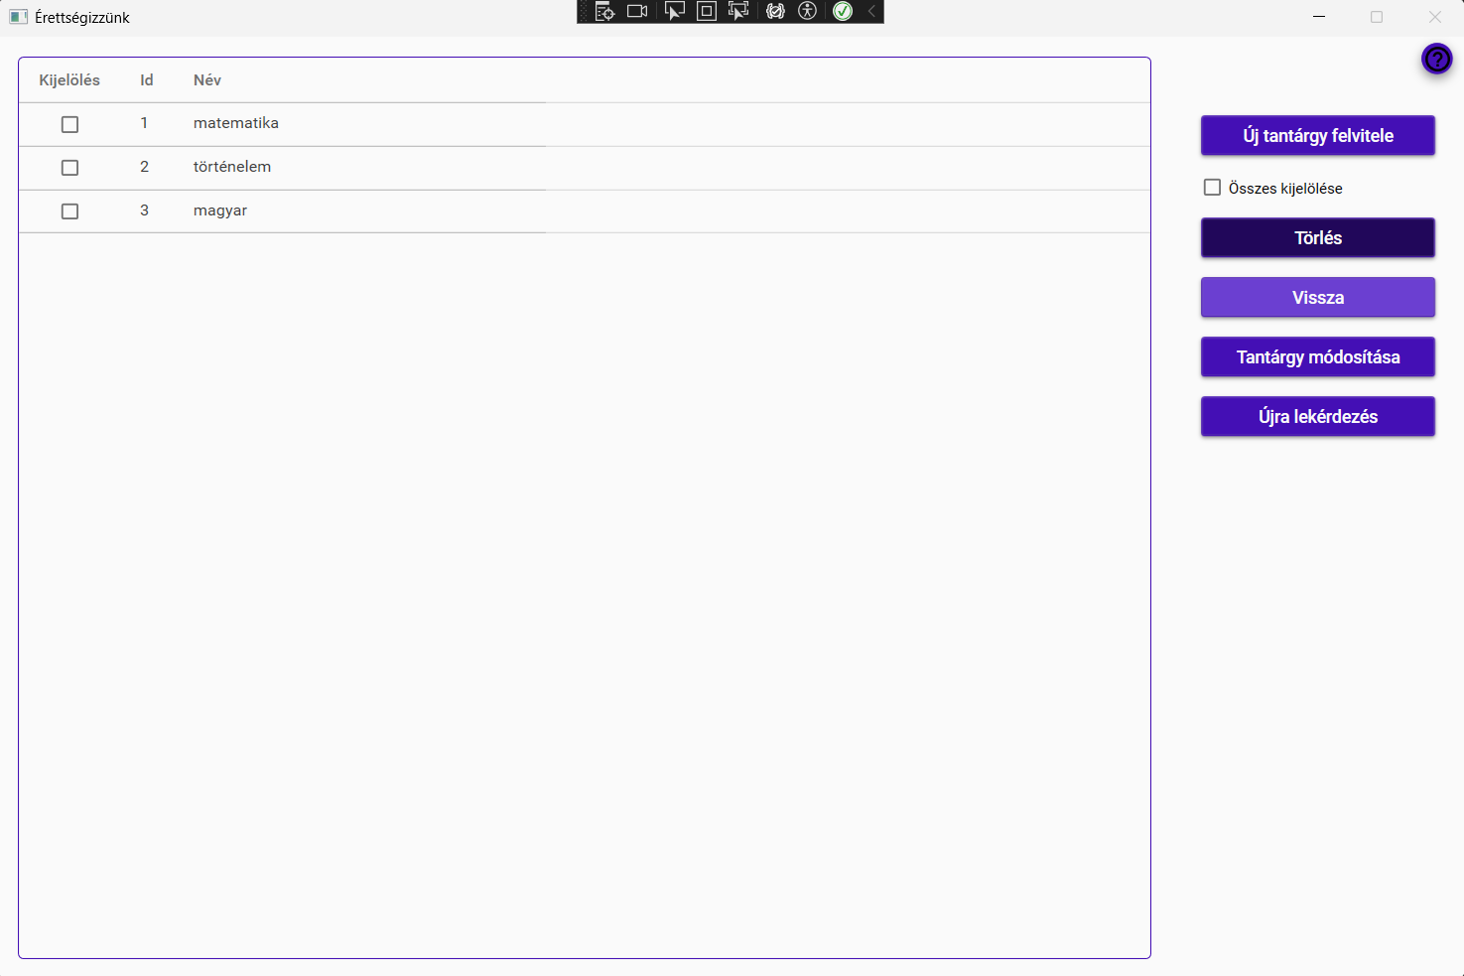
Main tasks:
Backend development
Development of the administrative interface
Olivér Bernát
Admin interface:
Zsolt Gáspár
Dárius Lipták

Slide 8
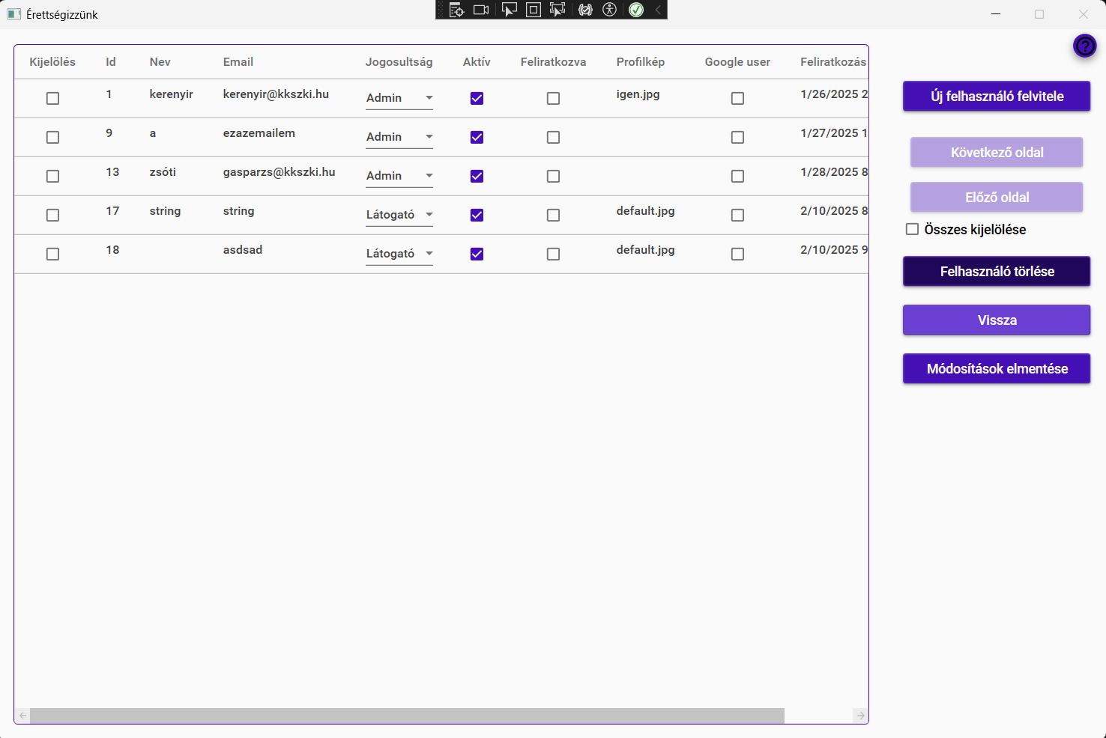
Main tasks:
Backend development
Development of the administrative interface
Olivér Bernát
Admin interface:
Zsolt Gáspár
Dárius Lipták

Slide 9
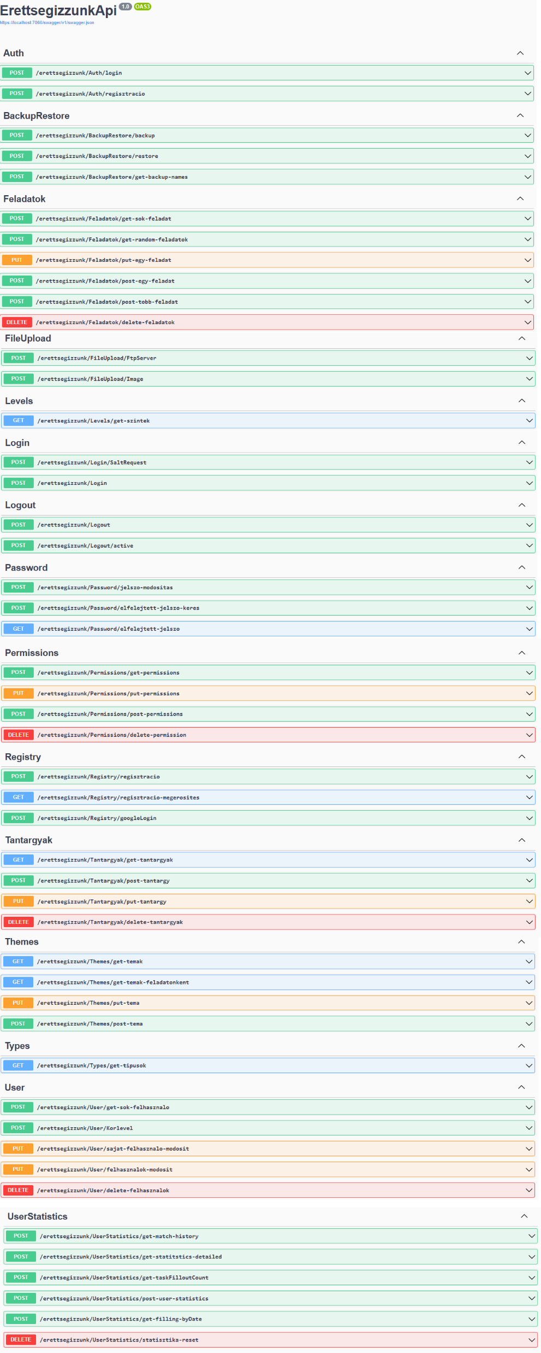
Main tasks:
Backend development
Development of the administrative interface
Olivér Bernát
Admin interface:
Zsolt Gáspár
Dárius Lipták

Slide 10
Main tasks:
Backend development
Development of the administrative interface
Olivér Bernát
Admin interface:
Zsolt Gáspár
Dárius Lipták

Slide 11
Main tasks:
Backend development
Development of the administrative interface
Olivér Bernát
Admin interface:
Zsolt Gáspár
Dárius Lipták

Slide 12
Olivér Bernát
Zsolt Gáspár
Dárius Lipták

Slide 13
Olivér Bernát
Zsolt Gáspár
Dárius Lipták

Slide 14
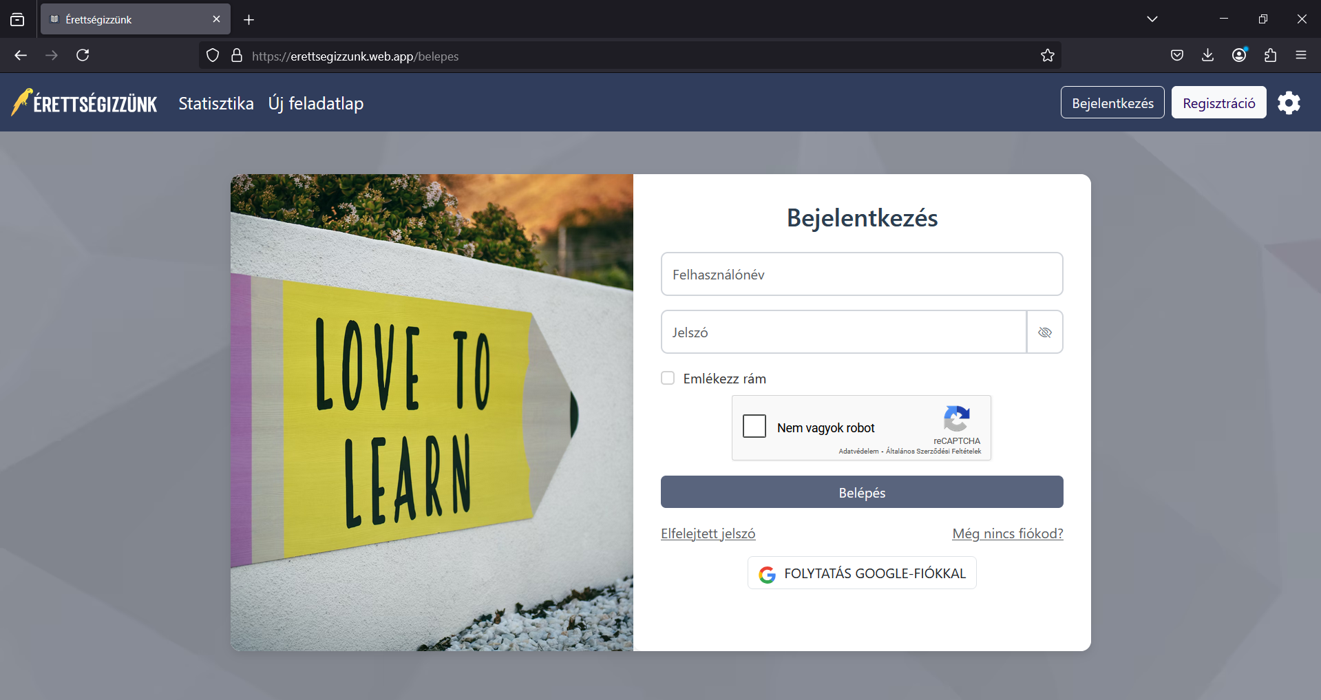
Main tasks:
Frontend development
Zsolt Gáspár
Login:
Olivér Bernát
Dárius Lipták

Slide 15
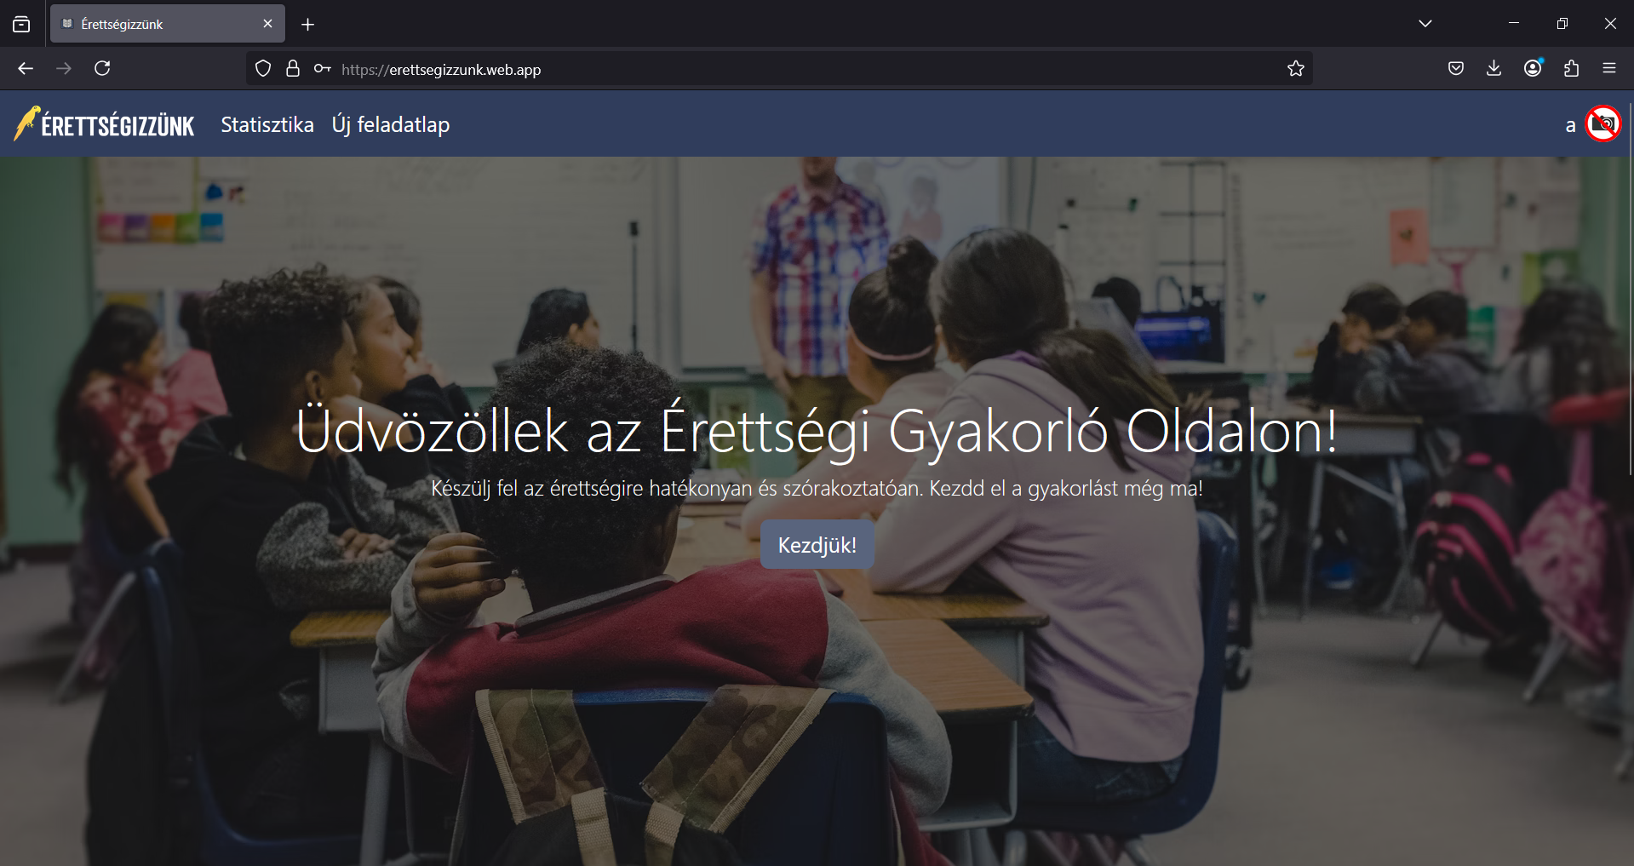
Main tasks:
Frontend development
Zsolt Gáspár
Login:
Olivér Bernát
Dárius Lipták

Slide 16
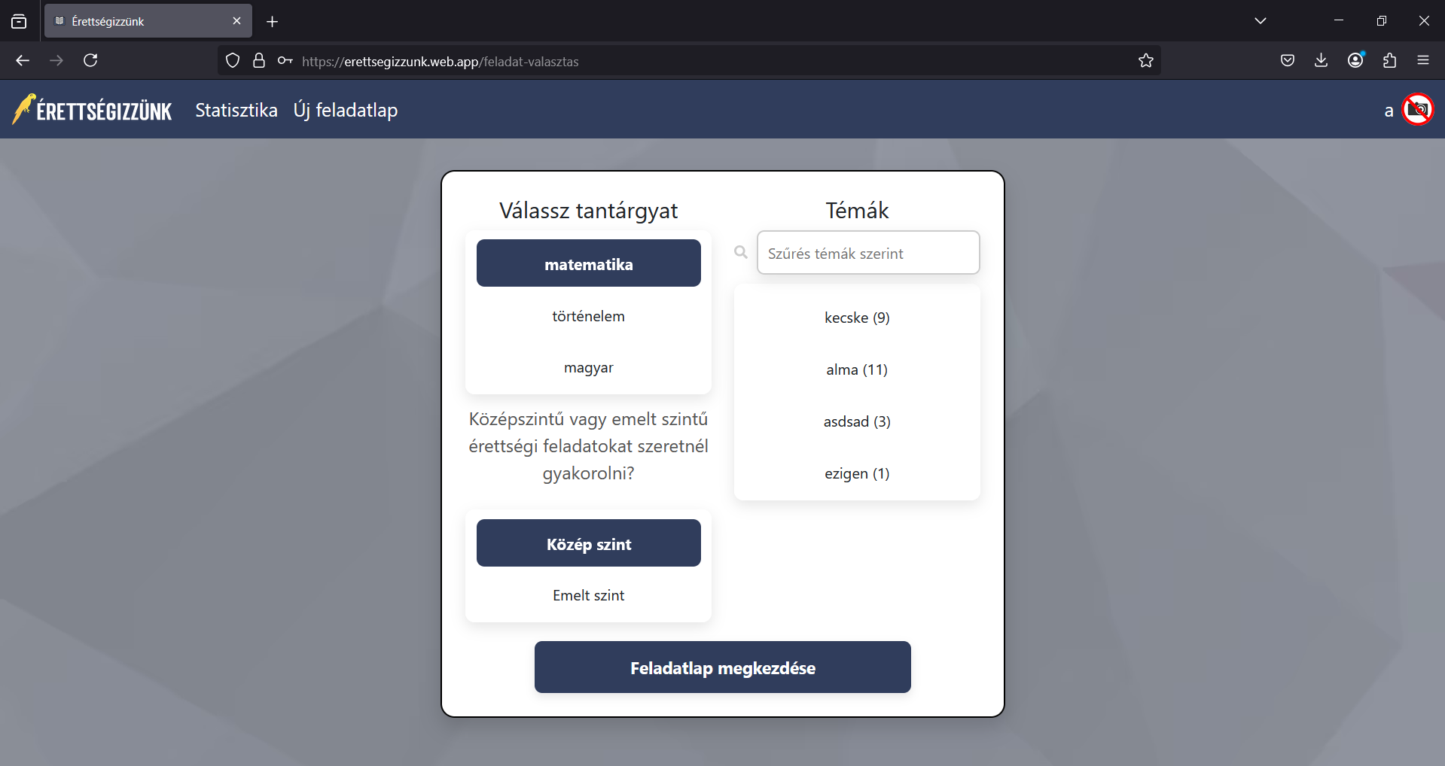
Fő feladatok:
Frontend development
Zsolt Gáspár
Main Menu:
Olivér Bernát
Dárius Lipták

Slide 17
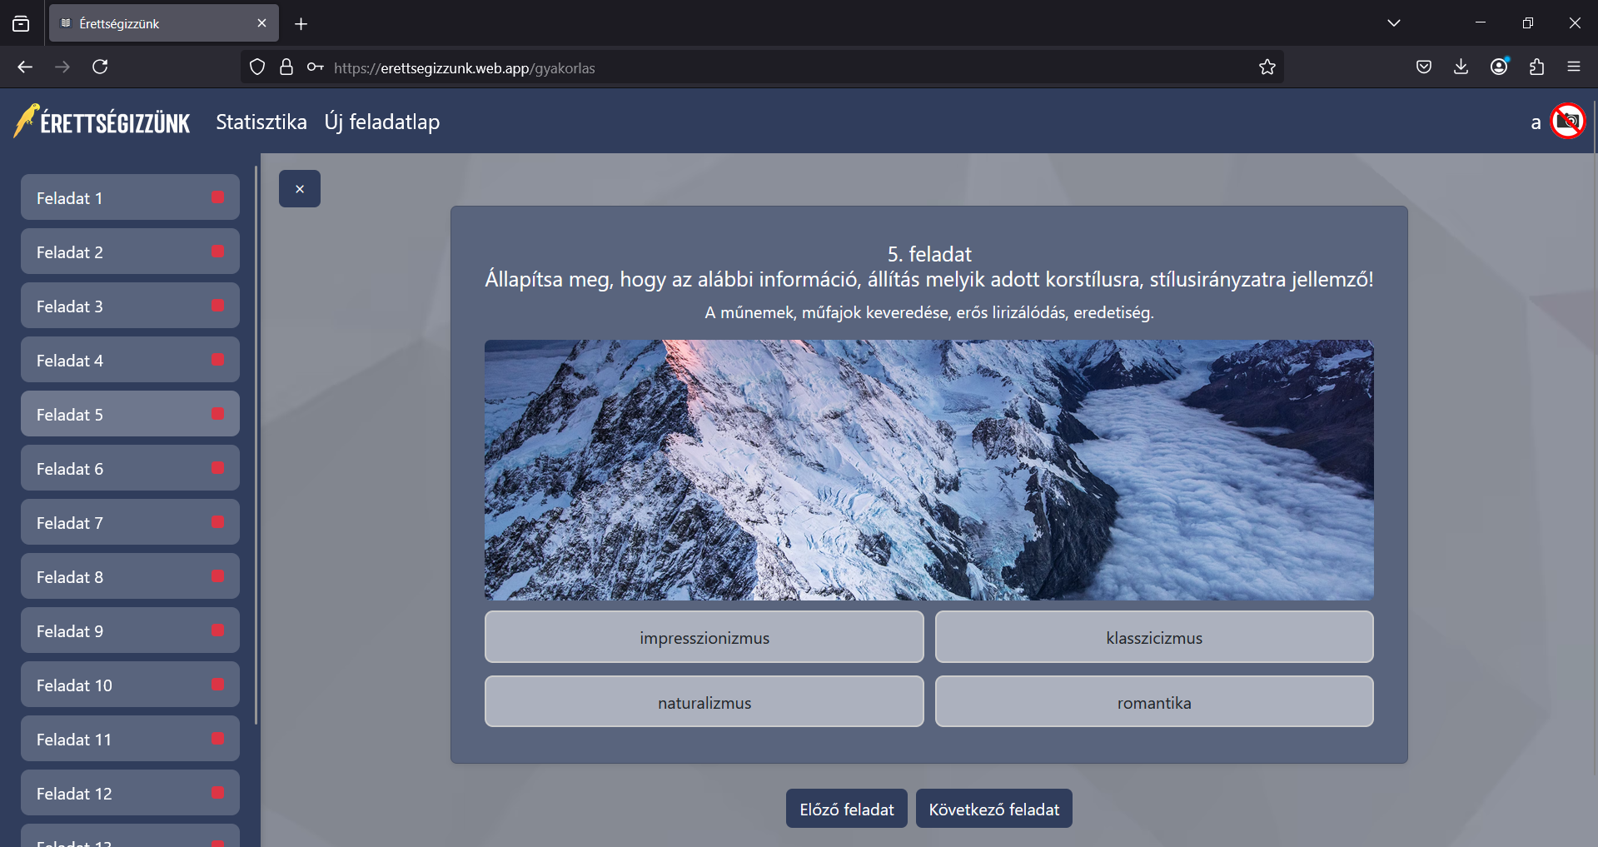
Main tasks:
Frontend development
Zsolt Gáspár
Task Selector:
Olivér Bernát
Dárius Lipták

Slide 18
Main tasks:
Frontend development
Zsolt Gáspár
Test interface:
Olivér Bernát
Dárius Lipták

Slide 19
Main tasks:
Frontend development
Zsolt Gáspár
Statistics interface:
Olivér Bernát
Dárius Lipták

Slide 20
Olivér Bernát
Zsolt Gáspár
Dárius Lipták

Slide 21
Olivér Bernát
Zsolt Gáspár
Dárius Lipták

Slide 22
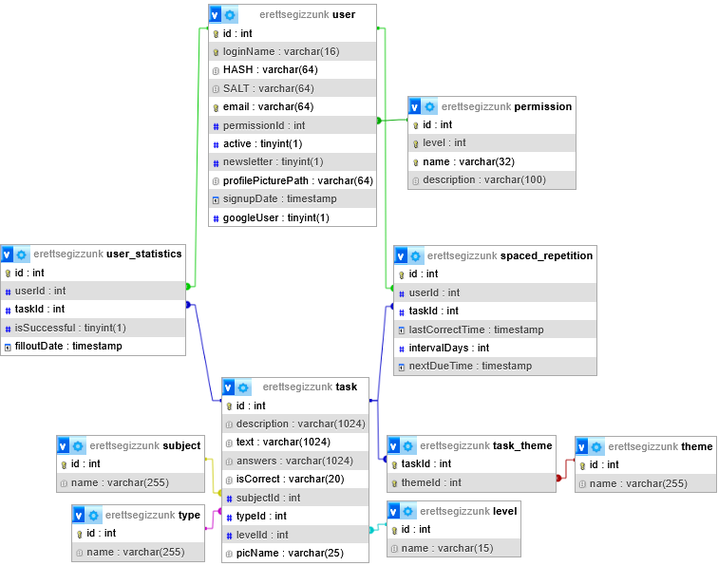
Main tasks:
Database maintenance
Mobile app development
Testing
Dárius Lipták
Database:
Olivér Bernát
Zsolt Gáspár

Slide 23
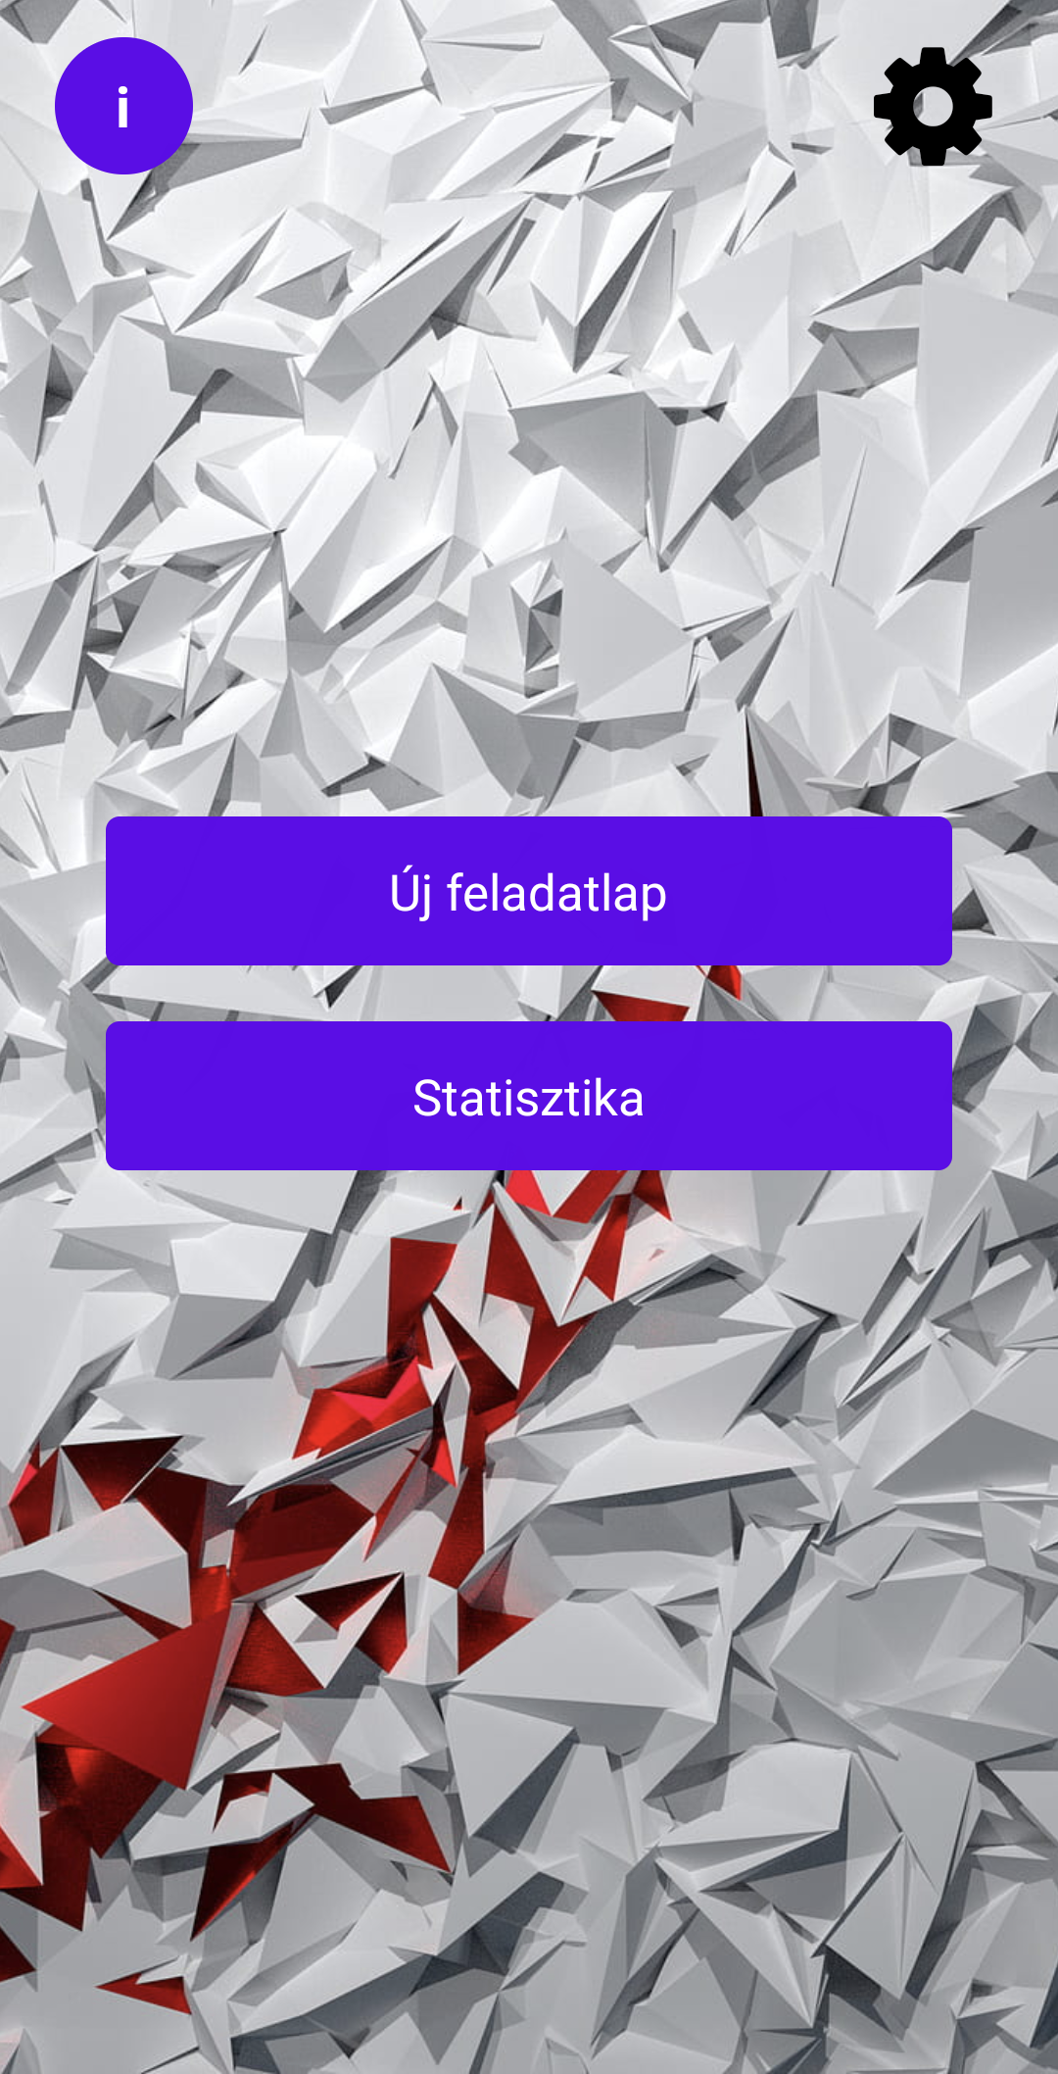
Main tasks:
Database maintenance
Mobile app development
Testing
Dárius Lipták
Database:
Olivér Bernát
Zsolt Gáspár

Slide 24
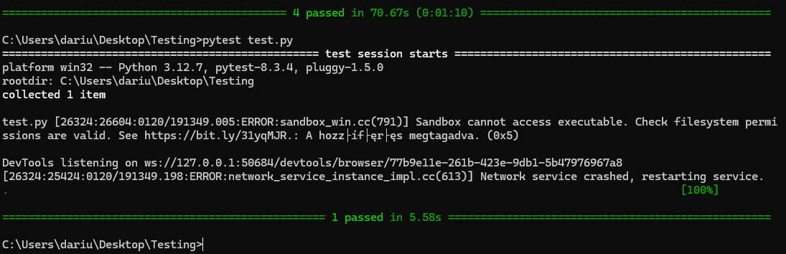
Main tasks:
Database maintenance
Mobile app development
Testing
Dárius Lipták
Mobile interface: WIP
Olivér Bernát
Zsolt Gáspár

Slide 25
Main tasks:
Database maintenance
Mobile app development
Testing
Dárius Lipták
Testing:
Olivér Bernát
Zsolt Gáspár

Slide 26
Main tasks:
Database maintenance
Mobile app development
Testing
Dárius Lipták
Testing:
Olivér Bernát
Zsolt Gáspár

Slide 27
Olivér Bernát
Zsolt Gáspár
Dárius Lipták

